Slide 1
Deploy Static HTML to Docker container
dotnetmastery.com

Slide 2
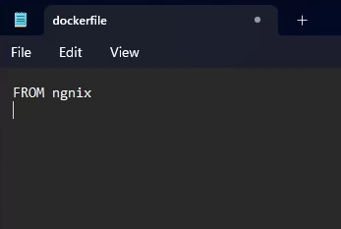
DOCKER – file creation
docker file has no extension
For creating a docker container we need docker image
For importing image we use FROM keyword
dotnetmastery.com

Slide 3
DOCKER – file creation
After importing the required image we have to copy all the files that we are going to add to in docker container.
We use COPY keyword for this.
dotnetmastery.com

Slide 4
DOCKER – Build a docker image
docker build –t {dockerimagename} .
NOTE: docker image name should be in lower case, and the above command should be ran in the same directory where we have docker file created
dotnetmastery.com

Slide 5
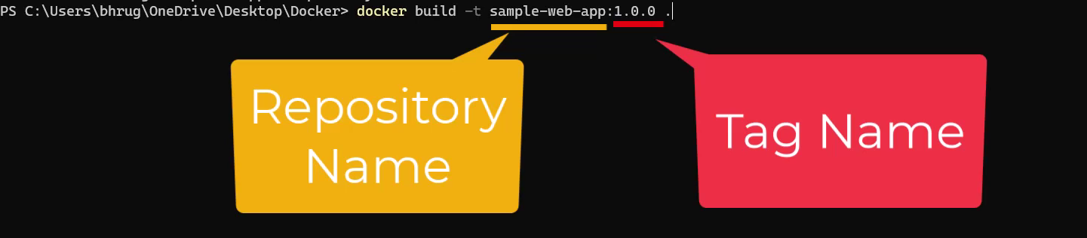
DOCKER – Build a docker image
docker build –t {dockerimagename}:1.0.0 .
NOTE: We can give tag to the docker image by using “:” followed by tag
dotnetmastery.com

Slide 6
DOCKER – Build a docker image
If Build is successful we will have image.
Check it by docker images
dotnetmastery.com

Slide 7
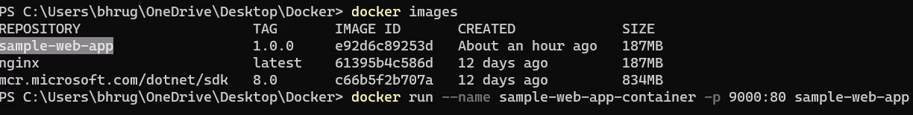
DOCKER – Building Container
Docker run -–name {containername}
-p tag is used for port mapping
Followed with repository name that we have.
dotnetmastery.com

Slide 8
DOCKER – Port Mapping
Docker run –name {containername}
-p tag is used for port mapping between host and container.
dotnetmastery.com

Slide 9

Docker - PORT Mapping
http://170.155.10.33:9000
9000
http://170.155.10.33
80
http://172.17.0.2:80
.NET App
172.17.0.2
Internal IP
Docker Container
Docker Host
docker run –p 9000:80 sample-web-app:1.0
dotnetmastery.com

Slide 10
Docker - PORT Mapping
http://170.155.10.33:9000
http://localhost:9500
http://dotnetmastery.com
9000
9500
7000
80
80
5000
http://172.17.0.2:80
.NET App
.NET App
.NET App
172.17.0.2
172.17.0.3
172.17.0.4
Internal IP
Docker Container
Docker Container
Docker Container
Docker Host
docker run –p 9000:80 sample-web-app:1.0
dotnetmastery.com

Slide 11
DOCKER – Container Commands
docker start 8820b248da9d
docker stop 8820b248da9d
docker restart 8820b248da9d
docker kill 8820b248da9d
Kill will exit the container with status 137
NOTE: You can use either container id (full/partial till it is unique) or container name
dotnetmastery.com

Slide 12
DOCKER – List all container’s
docker ps
NOTE: docker ps command displays only active containers
dotnetmastery.com

Slide 13
DOCKER – Remove a container
docker rm d8b24f3b6773
docker rm d8b
docker rm sample-web-app-containerv2
NOTE: Container cannot be removed if it is running. It must be first stopped
dotnetmastery.com

